Slide 1
Big Data Architecture and Governance
Individual Project | Brigham and Women’s Hospital
Navaneeta Naik

Slide 2
Brigham and Women’s Hospital
Industry: Healthcare
History/Background:
Brigham and Women's Hospital was established with the 1980 merger of three Harvard-affiliated hospitals
In the early 1990s, BWH pioneered Computerized Physician Order Entry (CPOE) to prevent medication errors, which is now a nationally-accepted safety practice. BWH has received patient safety awards for its electronic Medication Administration Record (eMAR) and barcoding system
In the 2019 U.S. News & World Report hospital rankings, BWH was ranked second in Massachusetts and thirteenth nationally
Their Research Institute is one of the most powerful biomedical research institutes in the world and the third largest recipient of National Institutes of Health (NIH) funding

Slide 3
SWOT Analysis
Strengths
Biomedical Research NIH funding
Use of Machine Learning and AI in CPOD
Competitive & Skilled Staff
High Annual Revenue $7.6B
Computerized Physician Order Entry (CPOE)
Efficient Supply Chain
Weaknesses
COVID-19 increased vacancy rates
Unpaid Internship
Staffing Management problems
Opportunities
Improvement of Leadership
Innovations in research
International Collaborations
Threats
Fierce Competitors – Dana Farber, Mass General
Staff loss due to better employment opportunities
Alternative Medicine

Slide 4
Project 1: BioMed Issue Description
Everyday, BWH witnesses a lot of patients with various medical backgrounds and health conditions.
The data from these patients can help in biomedical research and drug discovery
Using this huge amount of data can be very useful in various research studies and developing precision therapies and assessing risks of therapies and medications

Slide 5
Impact Statement : BioMed
Issue Name: BioMed
The purpose of this research study is to effectively assess and improve patient care and research at Brigham and Women’s Hospital

Slide 6
Project Mandate: BioMed
Page 1/3
PURPOSE
The purpose of this project is to provide analytics based on the data gathered from patients to be used for biomedical research and develop precision therapies at BWH Brigham Research Institute (BRI)
SPONSOR
The sponsor for this project will be Patient Centered Comparative Effectiveness Research Center’s leadership team that can access patient data, previous research data. The data analytics team will be responsible for processing this data and providing insights to various departments and the CIO will oversee these processes
BACKGROUND
This project is a part of the larger program at BRI that is the Patient Centered Comparative Effectiveness Research Center where they mainly focus on improving patient care and health reform. Using this project, data can be collected & processed to form meaningful reports and insights to improve patient care and research
4. PROJECT OBJECTIVES
This project will be able to process and use the data generated and harness it to conduct analysis and gain insights on the patient data to use it in research and providing this data in a meaningful way to practitioners to allow them to understand patient needs and precision therapies for various groups to cater to the needs.

Slide 7
Project Mandate: BioMed
Page 2/3
The cost in getting this data is not very high as the data will be collected from EHR, Biomedical research historical data, surgery records, patient records at BWH. The cost will however be outweighed by the profits and the forecasts that the researchers and practitioners will gain by the reports and insights provided by the project.
5. SCOPE
The major dependency of this project is the data that is generated by BRI data, patient records and EHR data . Based on the analytics provided by this data, better decisions can be made in terms of the therapies, research at BRI
6. CONSTRAINTS
Since this project is mainly based on data collection, analysis and deriving meaningful insights. One of the constraints associated with the project would be to get the required amount of resources such as the analytics team to perform the analytics. Also, the time required to distinguish the useful data from the collected (historical) data, can cause significant obstruction to the free flow of this project.
7. INTERFACES
The current and historical data collected from BWH and patients will be a major interface for this project. Data analysis, Business Intelligence will also be a major part in this project.

Slide 8
Project Mandate: BioMed
Page 3/3
8. QUALITY EXPECTATIONS
The quality expectation would be that the data collected, and the insights provided by this data will enable in better allocation of resources for research and improvement of the patient care
The key requirements for the project is rigorous data collection and analysis
The data collection should conform to or reference national and international standards and protocols, if they exist
9. OUTLINE BUSINESS CASE
The business justification for doing this project is to improve research at BWH Brigham Research Institute Patient Centered Comparative Effectiveness Research Center
The insights derived from this project will improve precision therapies and patient care at Brigham and Women’s Hospital

Slide 9














Vision Diagram: BioMed
DATA SOURCE
Patients Health Records
Hospital Data Records
Research Data
DATA INGESTION
Data Integration
Data Analysis
DESTINATION
Visualizations
Reports sent to BRI for drug discovery and precision medicine research

Slide 10
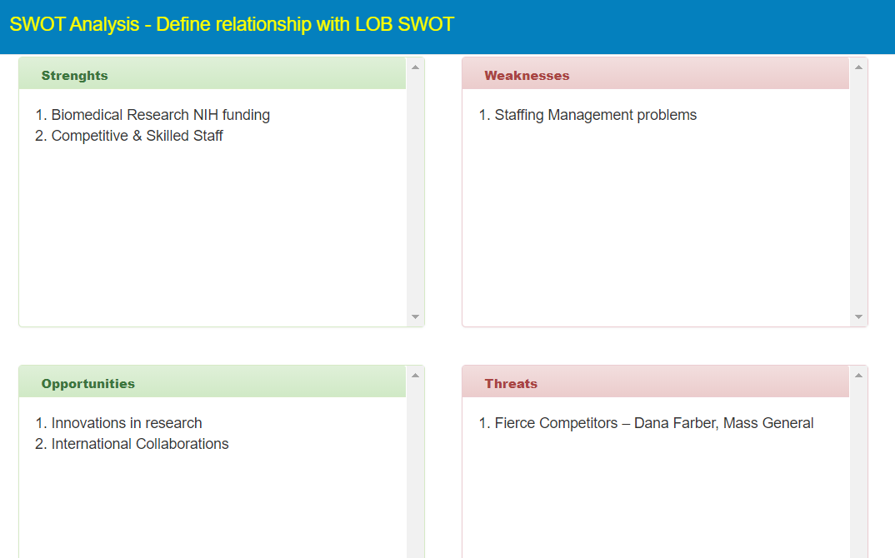
SWOT Analysis BioMed

Slide 11
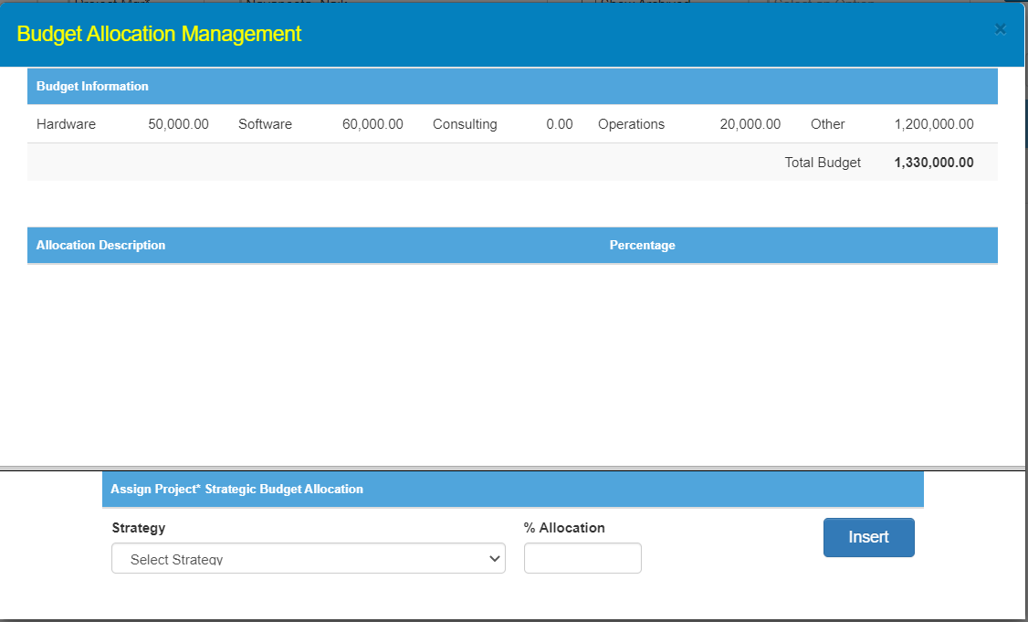
Budget Allocation: BioMed

Slide 12
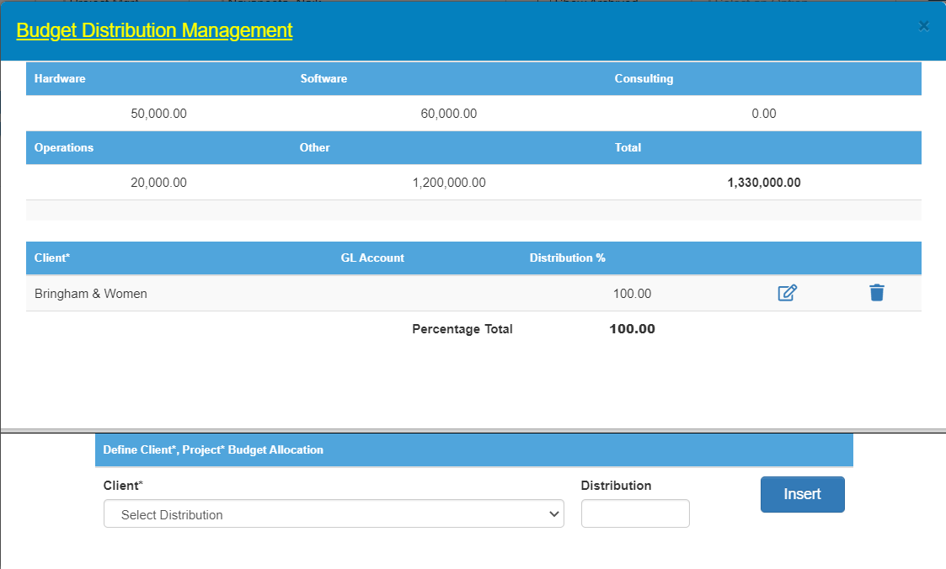
Distribution: BioMed

Slide 13
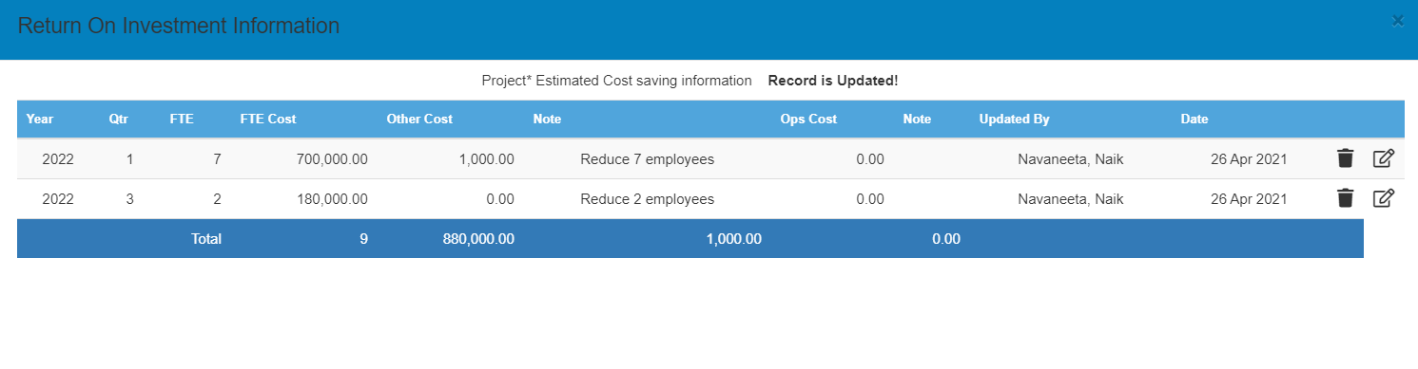
ROI: BioMed

Slide 14
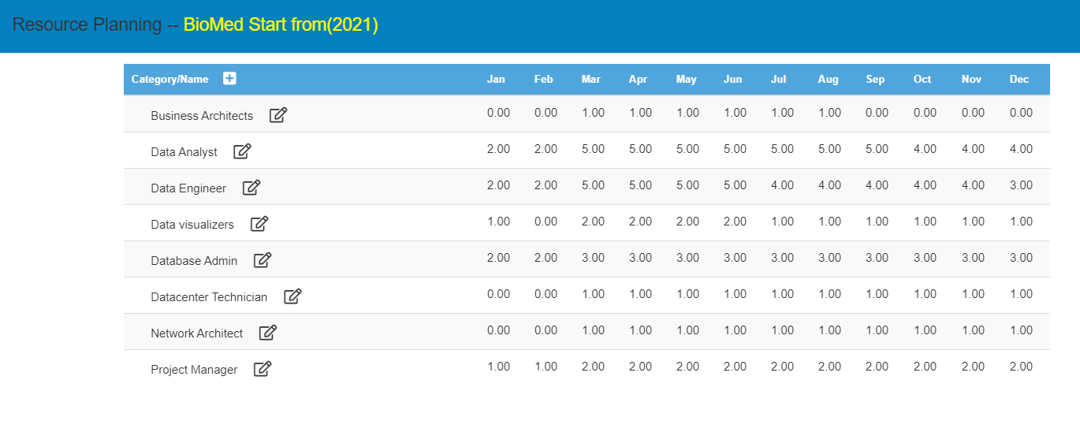
Resource Planning: BioMed

Slide 15
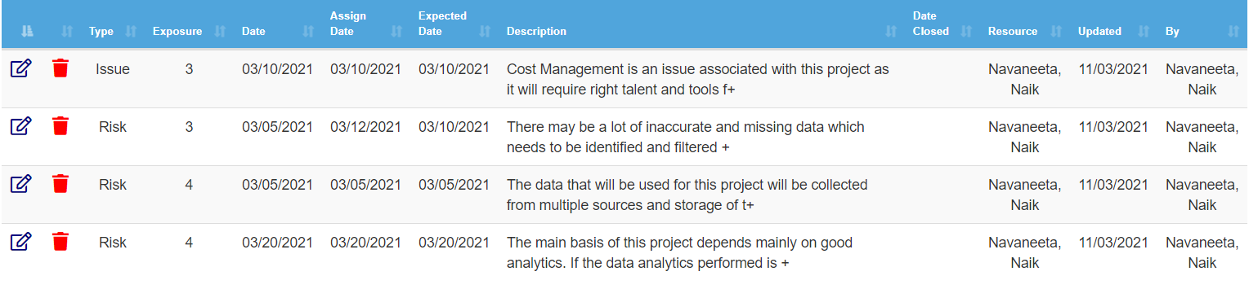
Risks & Issues: BioMed

Slide 16
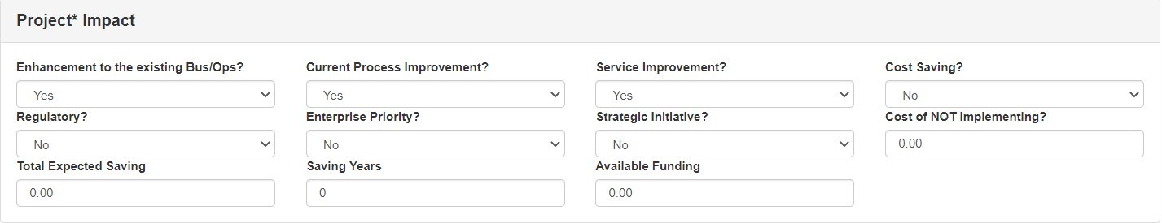
Impact: BioMed

Slide 17
Project 2: Cross Departmental EHR Issue Description
Once a patient is discharged after receiving the necessary medication, there is no way for the doctor to keep a tab on his health
After a few months, the same patient may come into a different department for a different issue
There is no data that will inform the doctor about the patient’s previous records of medications even within the same hospital
For this, healthcare providers or practitioners should have access to a huge amount of patient health data and be able to share it securely within different departments

Slide 18
Impact Statement: Cross Departmental EHR
Issue Name: Cross Departmental EHR
The aim of this project is to improve patient care and quality of services for patients at Brigham and Women’s Hospital.

Slide 19
Project Mandate: Cross Departmental EHR
Page 1/3
PURPOSE
The purpose of this project is to improve patient care and quality of services at Brigham and Women’s Hospital by giving an access to all medical and medication records of a patient across all departments.
SPONSOR
The sponsor for this project will be executives from the enterprise data team and asset management team. They will have access to EHR and data from various departments across BWH.
BACKGROUND
Healthcare providers or practitioners should have access to a huge amount of patient previous health data and be able to share it securely within different departments. The project will be a stand-alone activity to improve patient care.
PROJECT OBJECTIVES
The practitioner having access to all previous medical history of a patient across all departments over the years, will help determine patient health conditions and right track of medication and therapies. This will improve patient care at BWH and avoids unnecessary use of resources which will otherwise not be useful.

Slide 20
Project Mandate: Cross Departmental EHR
Page 2/3
The cost will be for getting a secure platform to share this data between departments, but that will be worth it because it will be helpful for practitioners and patients
5. SCOPE
The major deliverables of the Project is a secure way to share the EHR across the departments. The major dependencies would be that current and historical data will have to consolidated to generate a standardized data manual template so that it can be used across the departments
6. CONSTRAINTS
The constraints would be the availability of data from all departments, consolidation, data cleaning and processing
INTERFACES
All the patients’ data and historical data across all the departments is needed for this project. This can be a tedious and time-consuming process; hence integration tools and big data analysis can be used, and cloud services will be needed to store this huge data

Slide 21
Project Mandate: Cross Departmental EHR
Page 3/3
8. QUALITY EXPECTATIONS
The quality expectation would be that the data shared across the departments will help in the improvement of the patient care at Brigham and Women’s Hospital
The key requirements for the project is continuous data collection and updating, storage and ensuring appropriate maintenance of this data so it can be used by all the departments
The data collection and updating should conform to or reference national and international standards and protocols, if they exist and made sure that only authorized personnel get access to this secure data
9. OUTLINE BUSINESS CASE
The strategic need for the project is to improve how practitioners provide diagnosis, therapies and medication only based on symptoms without access to previous records of the patient
This data will help practitioners get access to secure patient data that can be used to improve patient care diagnosis and medication
This will also improve the reputation of the hospital a notch above where it stands now

Slide 22



Vision Diagram: Cross departmental EHR
DATA SOURCE
Electronic Health Records from all departments
DATA INGESTION
Masterdata
Access given to authorized people
DESTINATION
Masterdata
Data accessed securely by all departments’ authorized personnel

Slide 23
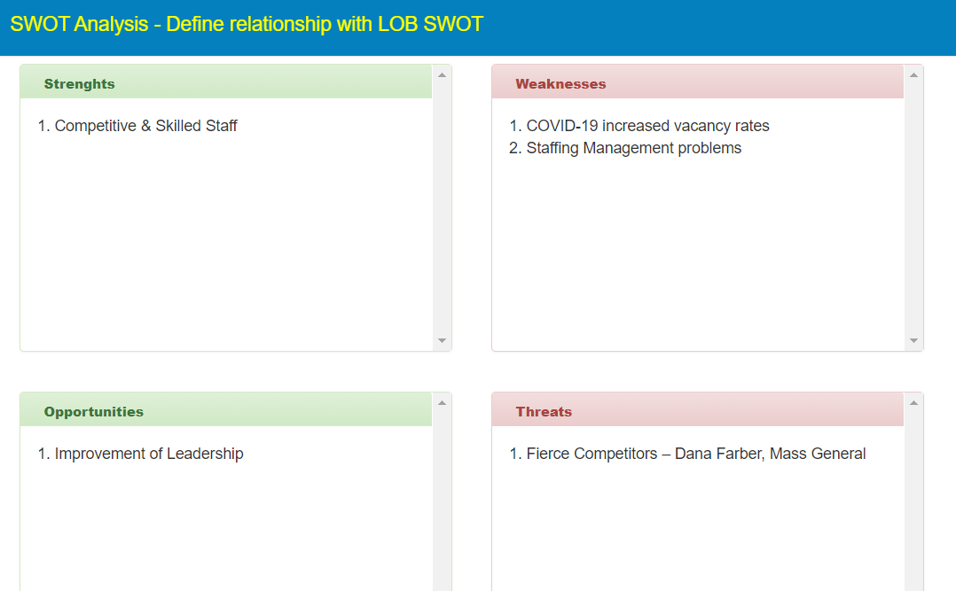
SWOT Analysis: Cross departmental EHR

Slide 24
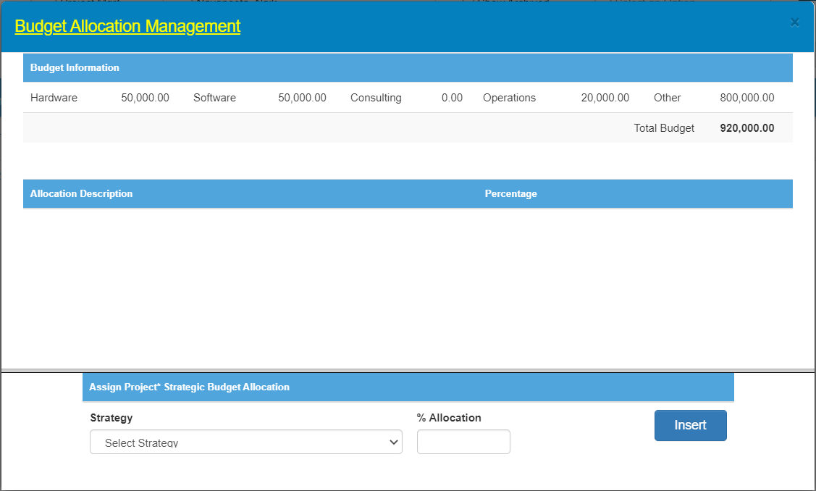
Budget Allocation: Cross departmental EHR

Slide 25

Distribution: Cross departmental EHR

Slide 26
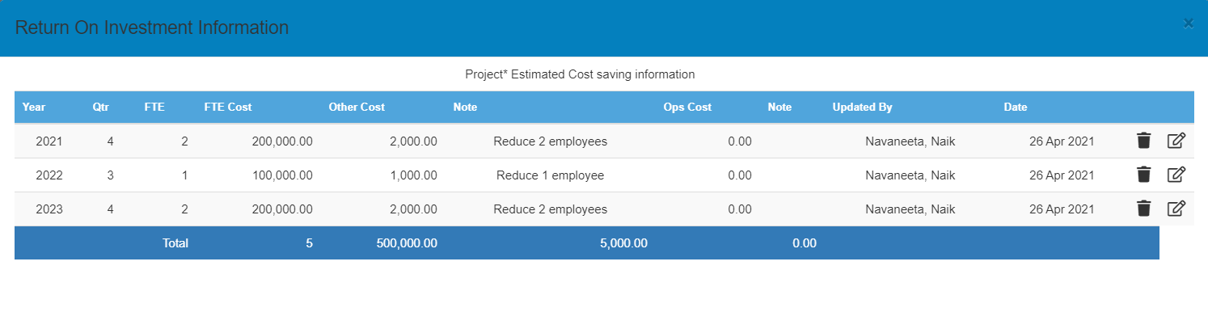
ROI: Cross departmental EHR

Slide 27
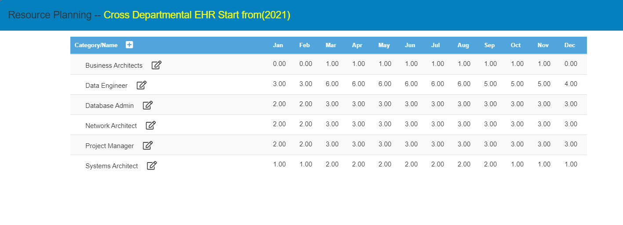
Resource Planning: Cross departmental EHR

Slide 28
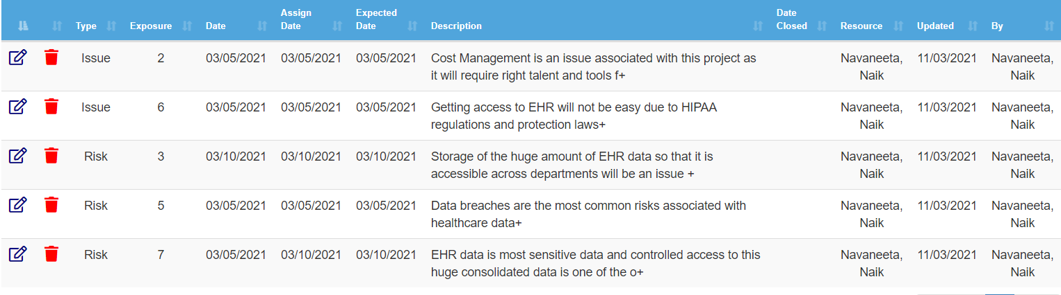
Risks & Issues: Cross departmental EHR

Slide 29
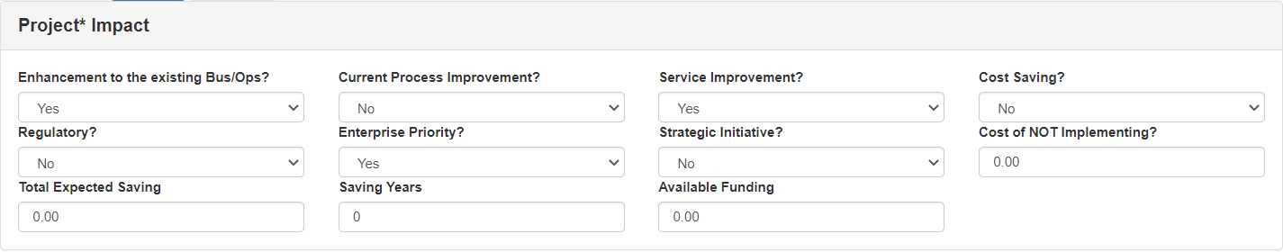
Impact: Cross Departmental EHR

Slide 30
Project Selection
Factors | BioMed | Cross Departmental EHR
Budget | $1,330,000 | $920,000
Return of Investment | $880,000 | $500,000
Impact | Improve Research at BRI | Improve Patient Care at BWH
Benefits | Drug Discovery & Precision Therapy studies | Helps physicians make better decisions and developing treatments

Slide 31
Project Selection
After considering the analytic and business prospects for the two projects, I would like to go ahead with the Cross Departmental EHR project.
Has a measurable and attainable goal
Less Investment
The success of this project is crucial for the betterment of patient care services at Brigham and Women’s Hospital
This project will help practitioners and patients at large by giving them a history of all patients securely

Slide 32
Functional & non-functional requirements

Slide 33
Functional Requirements
Data: The EHR data is available in many forms of structured and unstructured data, this will need to be integrated
Robust system: Since this project involves large amount of data, the system should be robust
Reporting: This data can be made available in the form of reports & dashboards to researchers and scientists for precision therapy & drug discoveries.
Authentication: Proper authentication needs to be placed as this is very sensitive patient information and only authorized people should get access to this information. Also, all the users must be monitored for suspicious activities
Cybersecurity: Data needs to be protected against data breaches, cyber threats
HIPAA compliance and laws regarding medical records need to be adhered

Slide 34
Non-Functional Requirements
Reliability
Availability: The system should always be up and running as the doctors would access it at any time
Correctness- The system should assure to provide correct & reliable information to the doctors
Performance
The system should ensure optimal performance for data acquisition, integration, storage & retrieval
There should be no data loss
Able to handle heterogeneous data sources
Usability
Must have well structured user manuals and informative error messages
Help facilities and tutorial videos to use the system data
Must have scheduled downtime and maintenance during the least affected time

Slide 35
Non-Functional Requirements
Security
The access permissions for system data may only be changed by the system’s data administrator
Only authorized people should get access to the data
All the data coming in must be backed up and be held in a secure system

Slide 36
Overall strategy & architecture

Slide 37










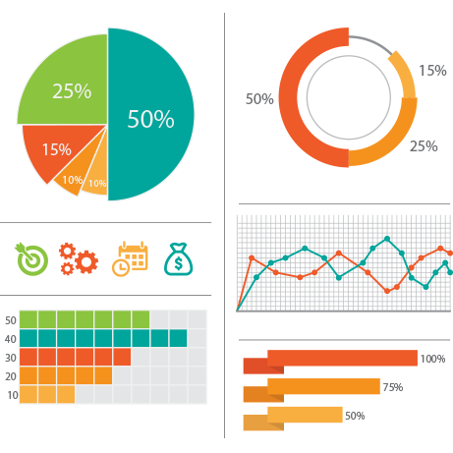




Vision Diagram
Data Source
Data Ingestion
Destination
Structured & Unstructured Data
End Users
Historical EHR
Radiology
Data access given to authorized doctors
Management
Pentaho Data Integration
Emails
Clinical Notes
Hadoop
Lab results
Audio files
Reports shared with Researchers
Visualization

Slide 38
Hadoop
Hadoop can be integrated with Pentaho
Hadoop’s scalability –Hadooponomics – Ability to scale data storage and processing in a linear fashion. Relies on Horizontal/Linear scaling
Scalable - Store and distribute very large data sets across hundreds of inexpensive servers that operate in parallel.
Cost effective - Scale-out architecture that can affordably store all data
Flexible - Access new data sources and tap into different types of data (both structured and unstructured) to generate value from that data
Fast - Storage method is based on a distributed file system that basically 'maps' data wherever it is located on a cluster
Resilient to failure - Data is sent to an individual node, that data is also replicated to other nodes in the cluster, which means that in the event of failure, there is another copy available for use

Slide 39
Pentaho
Pentaho provides the extract, transform and load functionality that is necessary for the EHR data that is stored in various forms
Pentaho has about 35 optimized data connectors such as SAP HANA connector, Microsoft Excel, SQL Lite, SQL Server, and Salesforce.com etc. which enables connecting to the data without any addon or third-party connectors.
The installation is fast and easy.
Connects to almost any data source as input & output
The data integration to handle the large flux of the data would be “Pentaho Data Integration”
Pentaho Kettle does not require the data to be stored in single data base or single source, it can work the same way even if the data is spread across.
When attempting to process the vast amounts of data collected on a daily basis for reporting, it is critical to have a Data Integration solution that is not only easy to use but easily extendable.

Slide 40
Hbase & Hive
HBase
A distributed column-oriented database built on top of the Hadoop file system
It provides random real-time read/write access to data in the Hadoop File System
HBase is a column-oriented database and the tables in it are sorted by row
Scalability- HBase can scale limitlessly as load and performance demands increase simply by adding server nodes
Apache Hive
Data warehouse software project built on top of Apache Hadoop for providing data summarization, query, and analysis.
SQL-like interface to query data stored in various databases and file systems that integrate with Hadoop.
Command Line Interface and UI (User Interface) allow an external user to interact with Hive by submitting queries. Provide more user defined interfaces to extend

Slide 41
Tableau
Business Intelligence tool for visually analyzing the data.
Create and distribute interactive and shareable dashboards which depict the trends, variations and density of the data in form of graphs and charts.
Connect to files, relational and Big data sources to acquire and process data.
Data blending and real time collaboration of huge data sets.
Visually representing data which was analyzed and will give a fast and easy to use for researchers.

Slide 42
VELERO

Slide 43
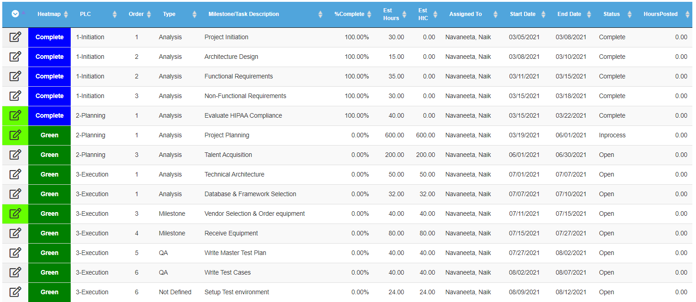
Complete project plan

Slide 44
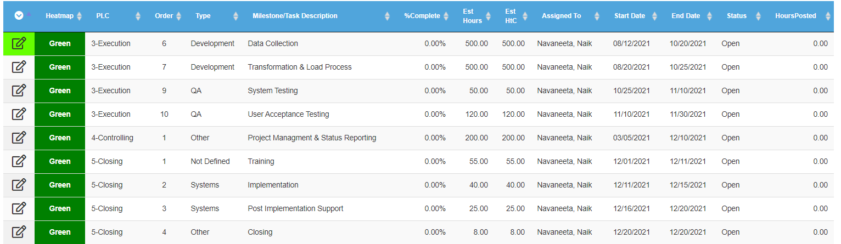
Complete project plan

Slide 45
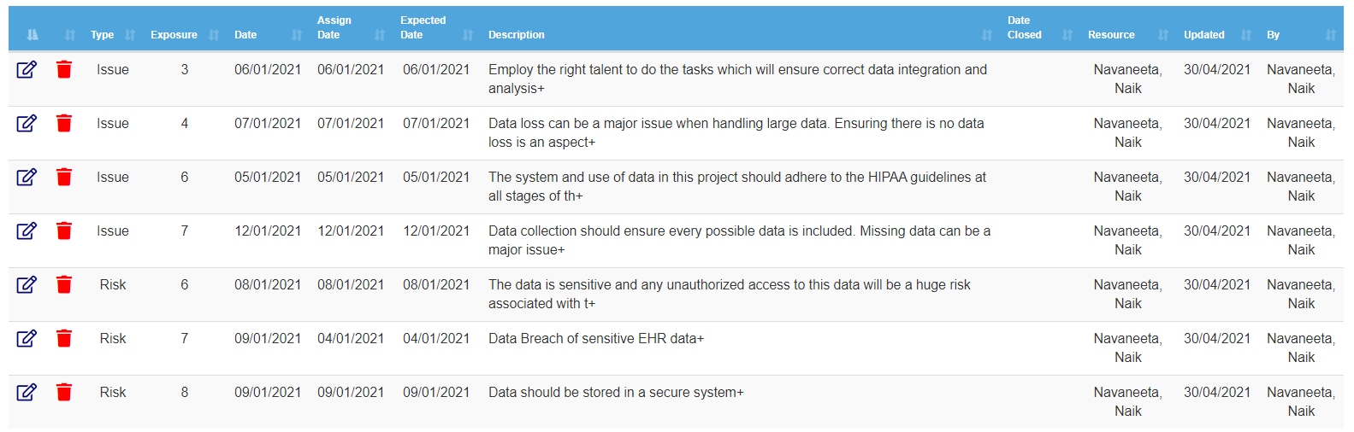
Issues & Risks

Slide 46
Data collection
The data source is present in the form of databases, text files and various other formats
This data from various sources are extracted using Pentaho
Then this data is transformed according to the business rules
Data from Pentaho is then loaded to the Hbase database
Hbase provides real-time read/write access to the HDFS (Hadoop File System)
HBase is used to store this data
Hive will be used for analytical querying of this data

Slide 47
Security
Hadoop:
Security features of Hadoop consist of authentication, service level authorization, authentication for Web consoles and data confidentiality
Data Encryption
Hadoop has begun using Kerberos authorization support to provide security. Kerberos allows for mutual authentication between client and server
Tableau:
Trusted Authentication -- a trusted relationship between Tableau Server and one or more web servers
OAuth for some cloud-based service providers
Native Authentication managed by Tableau Server Tableau provides automatic login timeouts that can be configured by administrators

Slide 48
Security
Zookeeper:
ZooKeeper now supports Kerberos security
Authorization is done via ACLs
Supports several types of restrictions - Message digest , Hostname, IP address
Can limit access by function - Read, write, delete, etc
Hbase:
The security protocol for the client authentication involves Kerberos and SSL
Database logging and security The data at rest on the under lying file system is transparently encrypted

Slide 49
Management: Apache Zookeeper
Apache Zookeeper is a service used by a cluster (group of nodes) to coordinate between themselves and maintain shared data with robust synchronization techniques.
Zookeeper is itself a distributed application providing services for writing a distributed application.
The performance of can be enhanced by adding more machine to it with minor changes in the configuration without any downtime.
Zookeeper is very performing management tool and very reliable compared to the other MDM tools
Benefits- fast, reliable, simple, ordered

Slide 50
THANK YOU

